Slide 1


Charjeram Wonderland
MINI PROJECT 2 - WD38
ARELLANO, CHARMAYN
DAVID, CHARMAINE
DURAN, RAMILO
PULIDO, JEREMY

Slide 2






Technologies used

Slide 3
Why Charjeram Wonderland?
Invite
adorn
Dance

Slide 4
Why Charjeram Wonderland?
Invite
adorn
Dance

Slide 5
Best Date for Party

Slide 6
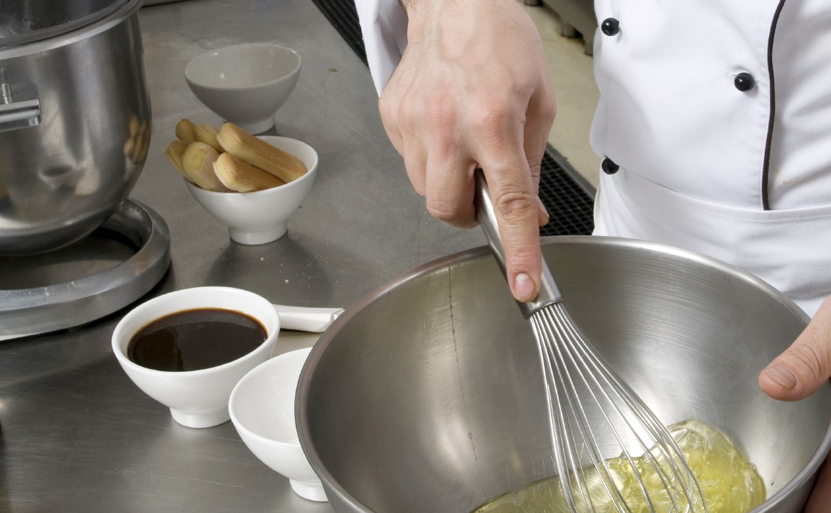

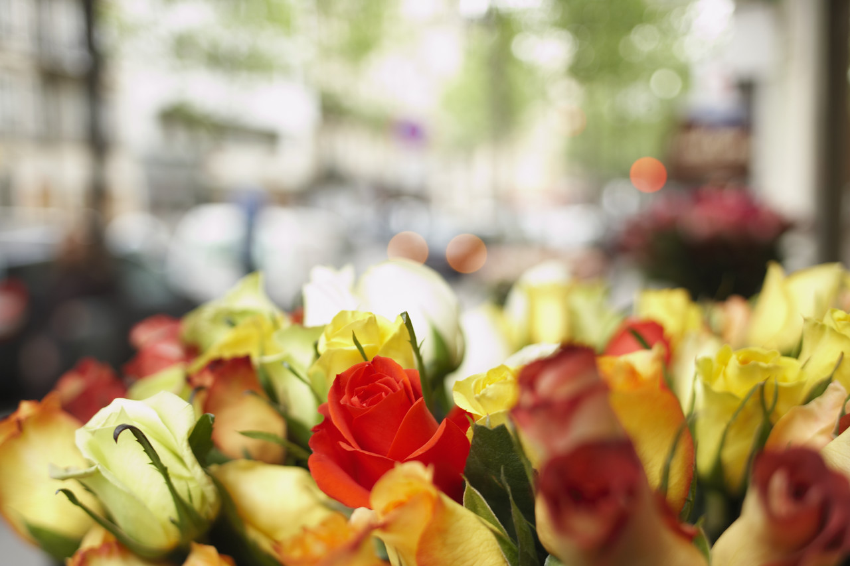
Party Committees
Food
Gifts
Decorations

Slide 7

Thank you
someone@example.com

